Slide 1




Logisim project
Digital clock and calender
Abhinay kumar
2201cs04
Cs227_digital system
Iitp b.tech. cse(3rd sem)

Slide 2
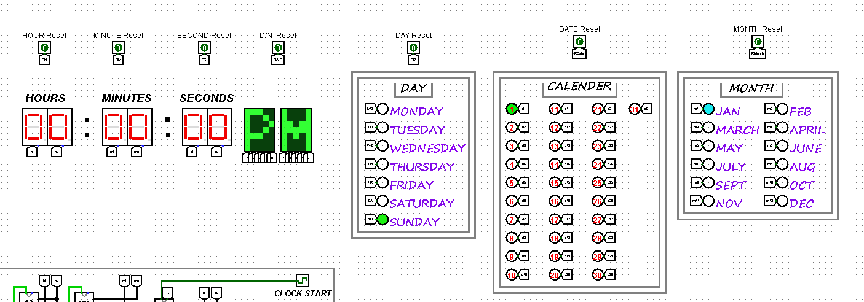
Aim: Implementation of digital clock and calender in LOGISIM using various compnents.
Components Used: Gates, flip flop, decoder, Multiplxer, hexa digit display, mod 10 counter, mod 6 counter, mod2, mod3, LED matrix.

Slide 3
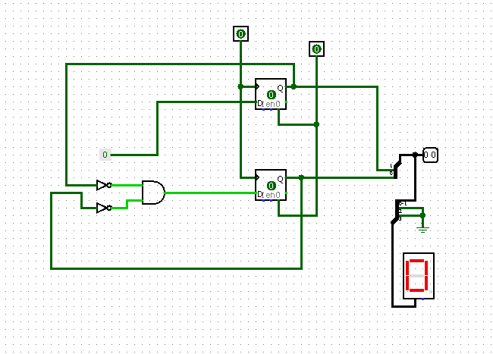
Hexa decimal Mod 2 counter: This will count from 0 to 1 upon giving clock

Slide 4
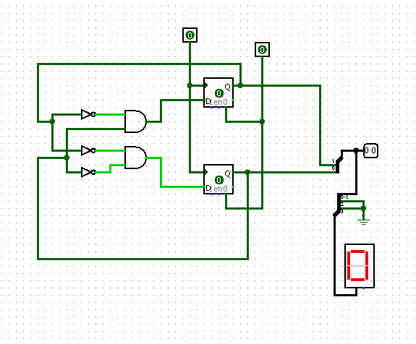
Hexa decimal Mod 3 counter: This will count from 0 to 2 upon giving clock

Slide 5
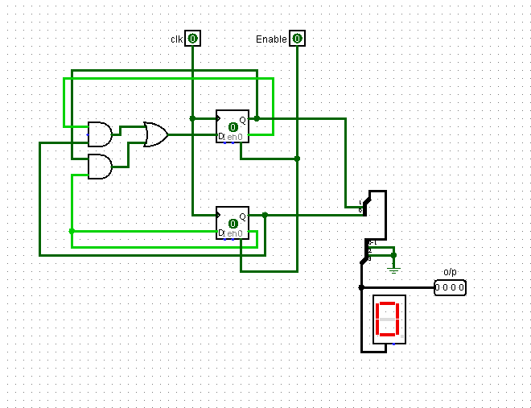
Hexa decimal Mod 4 counter: This will count from 0 to 3 upon giving clock

Slide 6
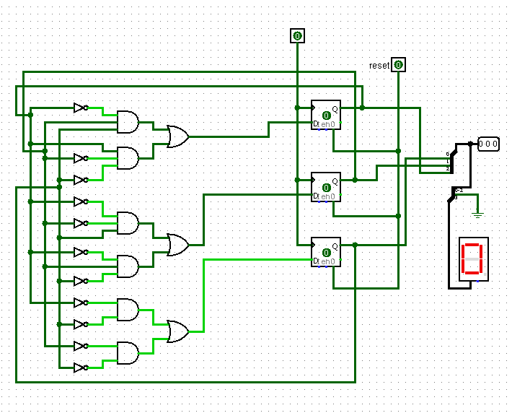
Hexa decimal Mod 6 counter: This will count from 0 to 5 upon giving clock

Slide 7
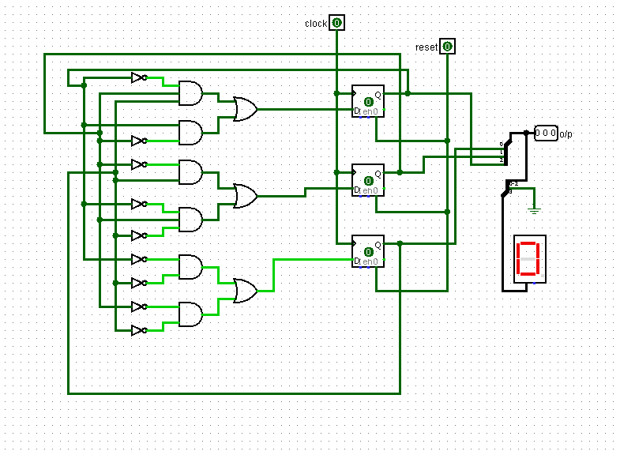
Hexa decimal Mod 7 counter: This will count from 0 to 6 upon giving clock

Slide 8
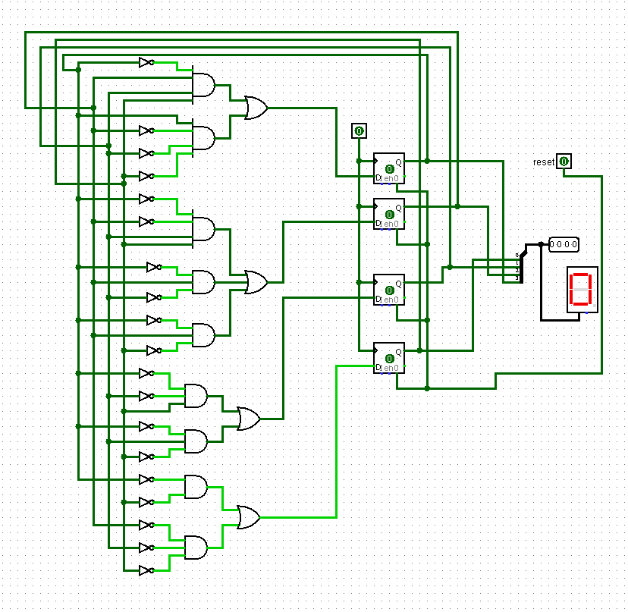
Hexa decimal Mod 10 counter: This will count from 0 to 9 upon giving clock

Slide 9
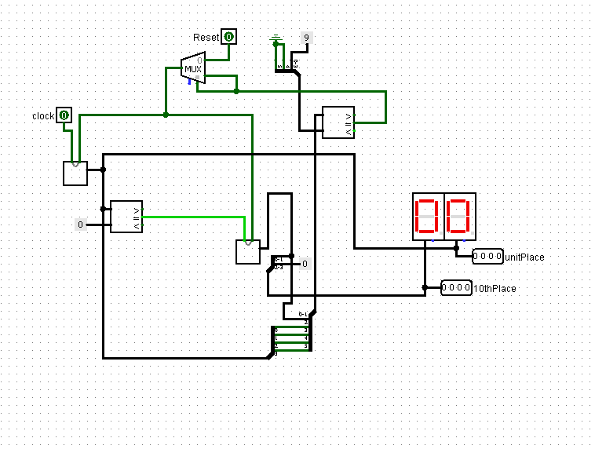
Hexa decimal Mod 12 counter: This will count from 0 to 11 upon giving clock

Slide 10
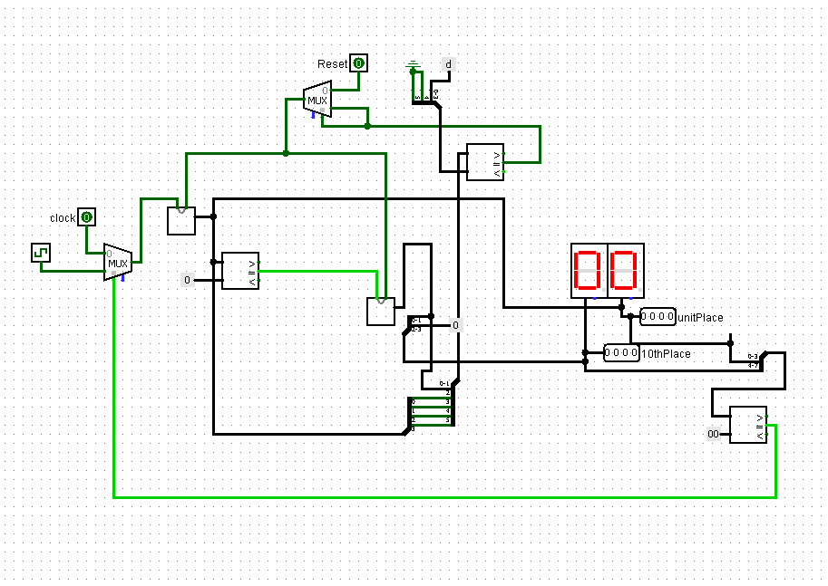
Hexa decimal Mod 12 counter: This will count from 1 to 12 upon giving clock

Slide 11
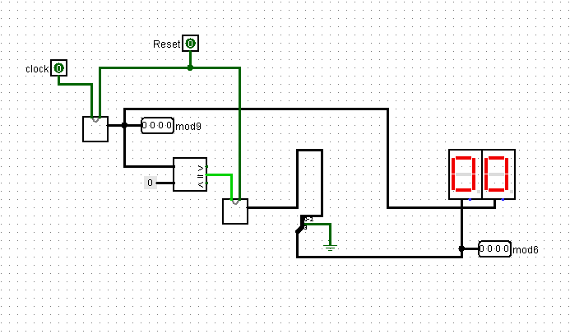
Hexa decimal Mod 60 counter: This will count from 0 to 59 upon giving clock

Slide 12
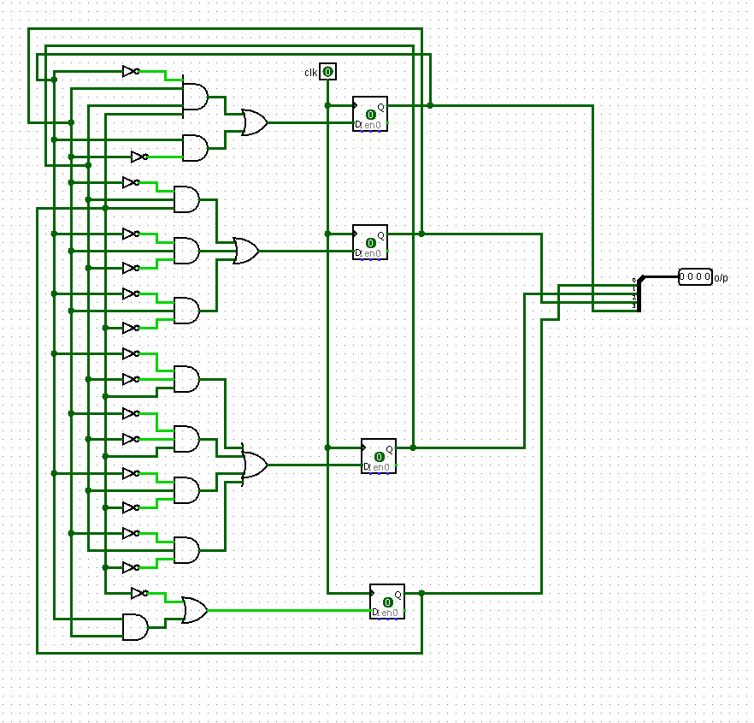
Binary Mod 12 counter: This will count from 0 to 11 upon giving clock

Slide 13
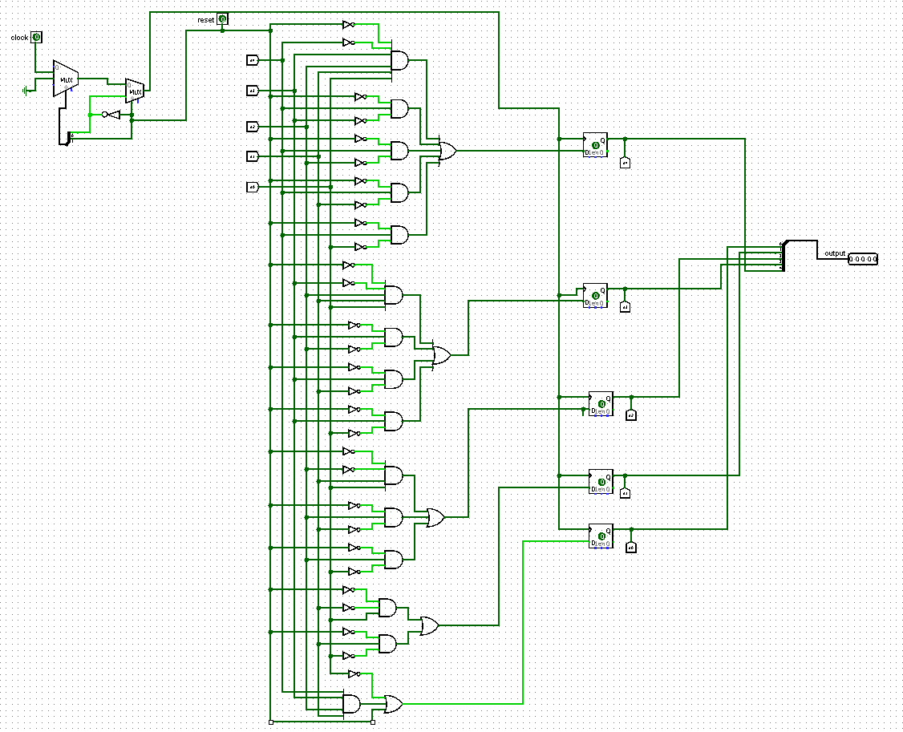
Binary Mod 31 counter: This will count from 1 to 31 upon giving clock

Slide 14
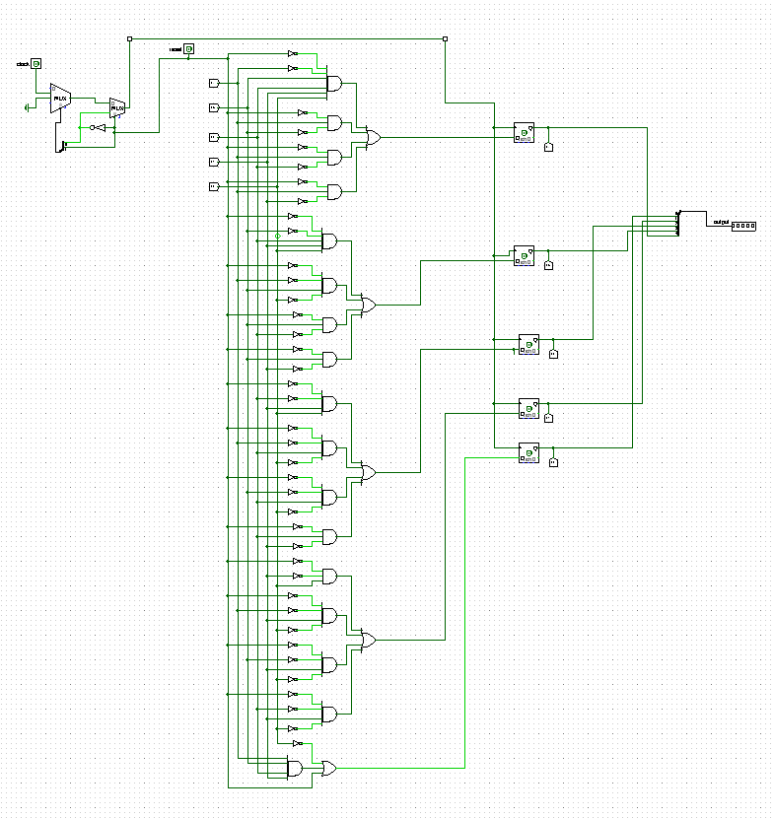
Binary Mod 30 counter: This will count from 1 to 30 upon giving clock

Slide 15
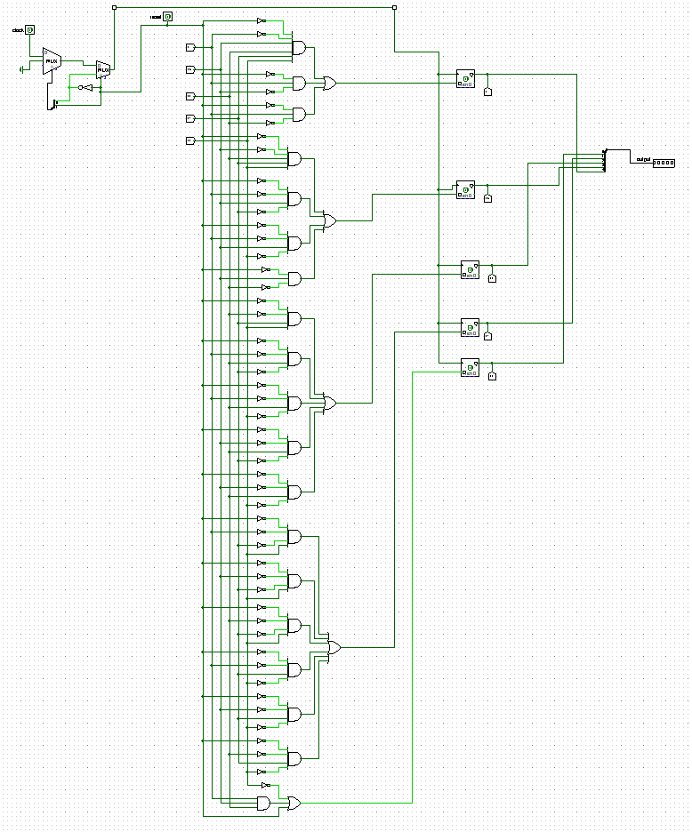
Binary Mod 28 counter: This will count from 1 to 28 upon giving clock

Slide 16
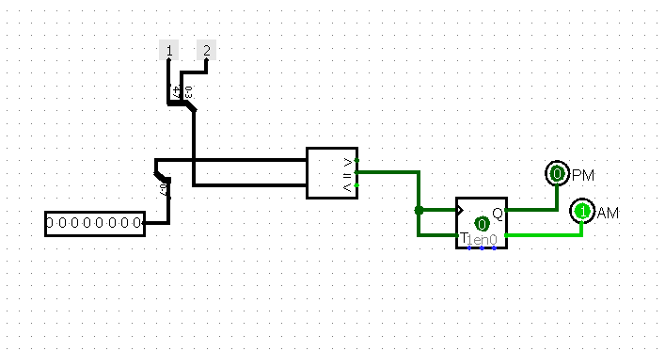
AM-PM change module: achange from AM to PM upon giving clock.

Slide 17
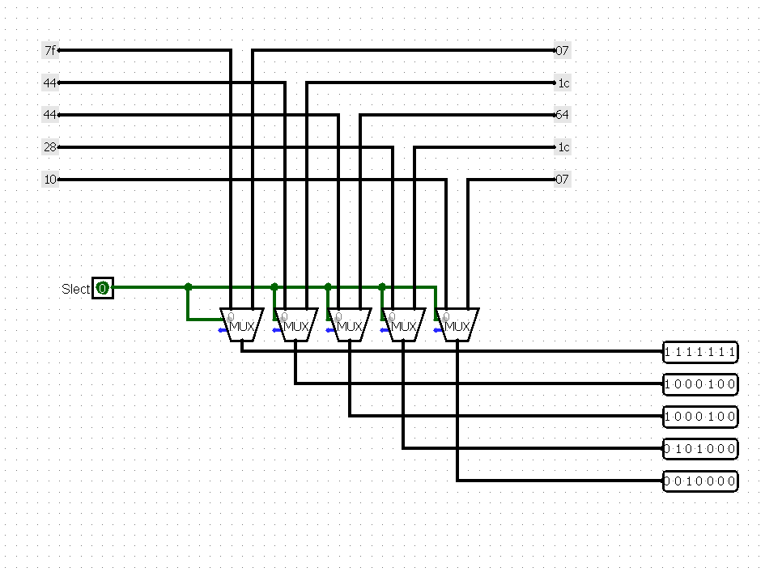
AM-PM change for LED matrix: This will display AM/PM on display.

Slide 18
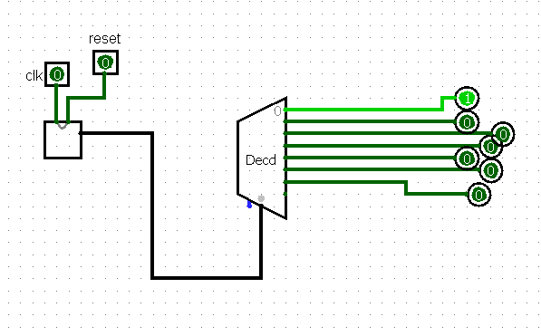
Day Module counter : it will change from 1-7 upon giving clock for days of week.

Slide 19
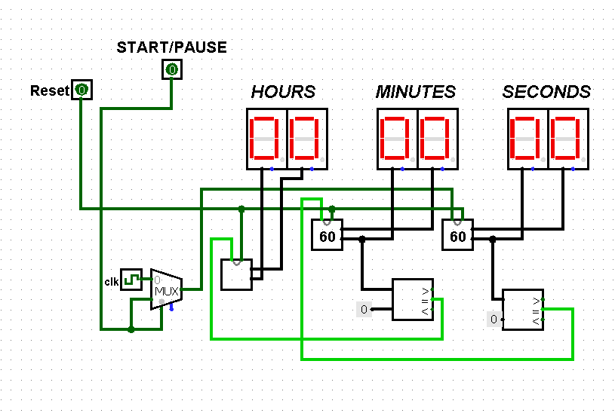
STOPWATCH:

Slide 20
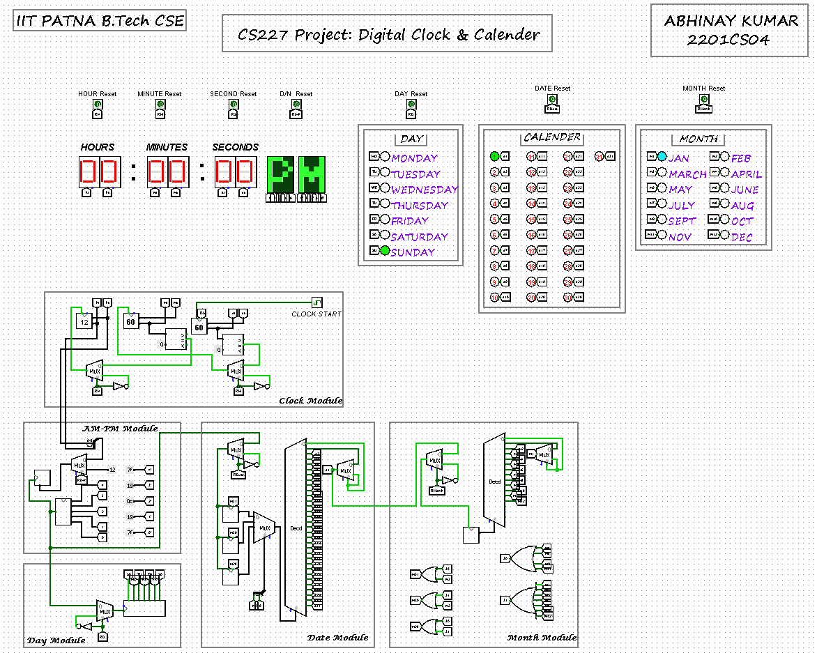
MAIN CIRCUIT:

Slide 21
Final Output of project:

Slide 22
Working Principle: this will work on the principle of clock pulse i.e. minute will change when second will comple 60, and hour will change when minute will complete 60. am-pm will change when hour will reach 12.
Day and date will change when PM – AM change occurs.
Month change when it will again reach 1.
Thank you….

